Slide 1
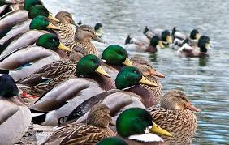
HOW DO ORGANISMS REPRODUCE
Reproduction is the biological process of producing young ones.
It enables continuity of species generation after generation.

Slide 2
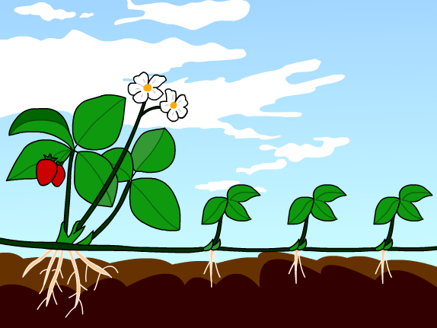
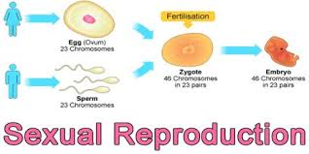
ASEXUAL REPRODUCTION AND SEXUAL REPRODUCTION

Slide 3
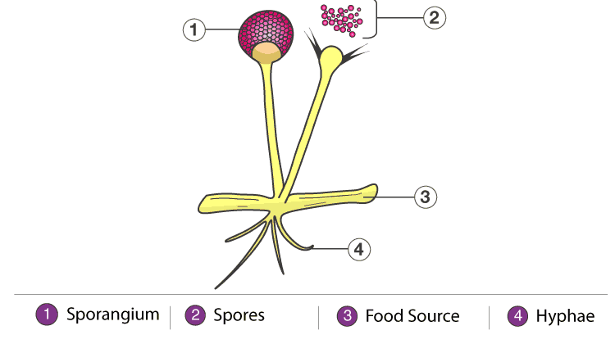
ASEXUAL REPRODUCTION
Asexual reproduction is a form of reproduction in which an organism gives rise to genetically-identical individuals.
It involves only single parent.

Slide 4
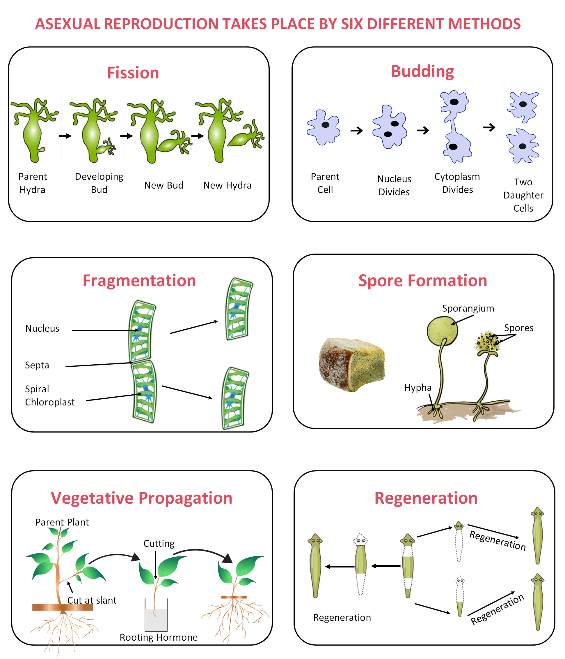
TYPES OF ASEXUAL REPRODUCTION
FISSION
FRAGMENTATION
BUDDING
REGENERATION
VEGETATIVE PROPAGATION
SPORE FORMNATION

Slide 5
FISSION
It is the process of division of a single Cell into two or more individuals
TYPES OF FISSION
1. BINARY FISSION
2. MULTIPLE FISSION

Slide 6
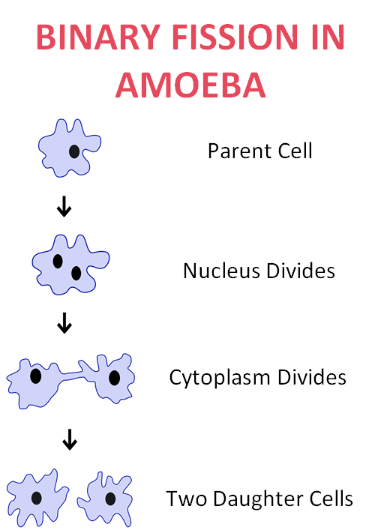
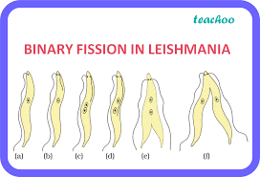
BINARY FISSION
Binary fission is a form of asexual reproduction by which the body splits into two new bodies.
Eg: AMOEBA AND LEISHMANIA

Slide 7
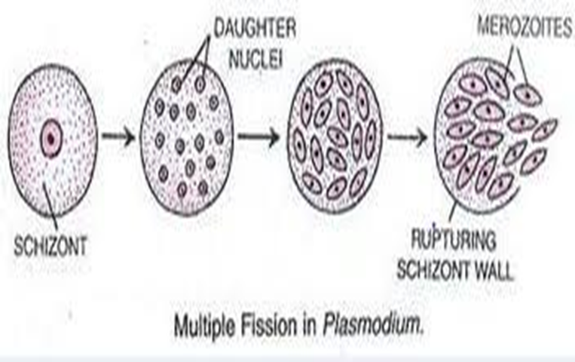
MULTIPLE FISSION
A single cell splits into many daughter cells are produced from the parent cell.
Eg: Plasmodium

Slide 8
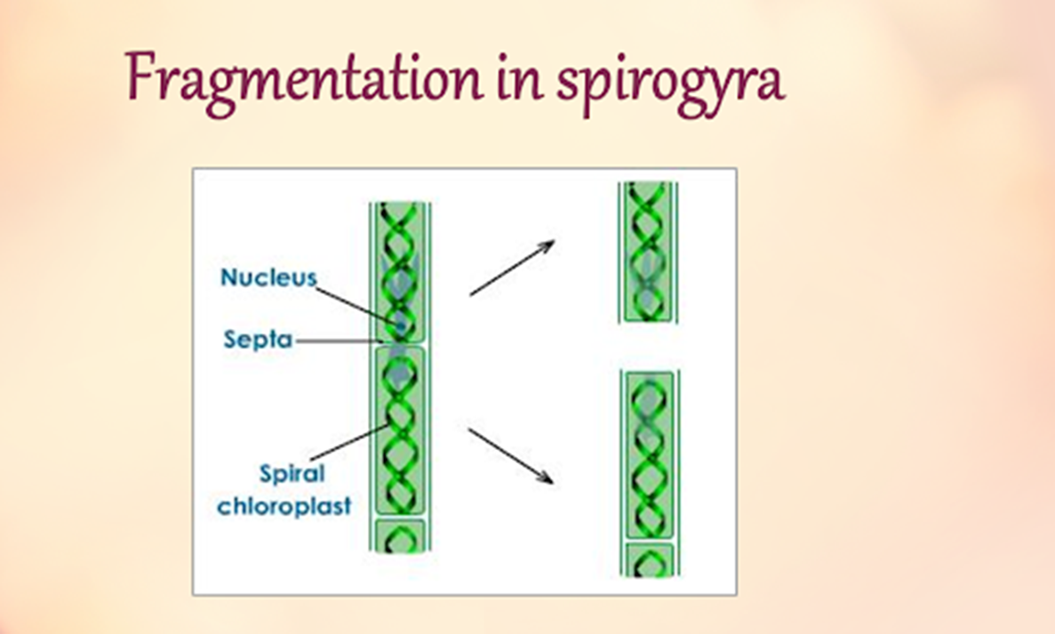
FRAGMENTATION
Body breaks into fragments. Each fragment develops into an organism
Eg: Spirogyra

Slide 9
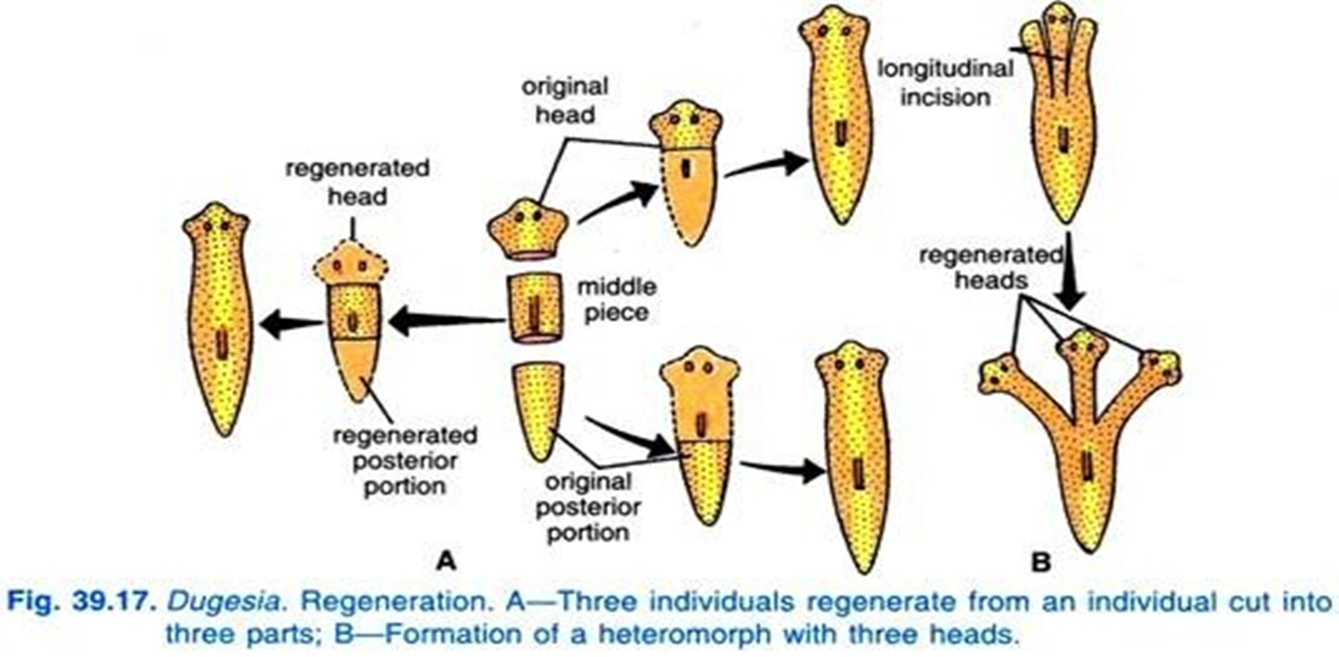
REGENERATION
Some organisms have Ability to give rise to new individual organism from lost body parts.
Eg: Planaria

Slide 10
Vegetative Propagation
It is a kind of asexual reproduction in which vegetative parts of a plant like stem, leaf and root grows into a new plantlet.
Vegetative propagation can occur naturally or artificially.
Types of natural vegetative propagation are tubers, runner, rhizomes and bulbs.
Types artificial vegetative propagation are cutting and grafting.

Slide 11
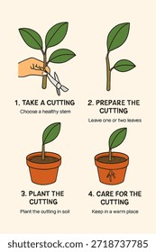
Vegetative Propagation
Cuttings
Pieces of a root or stem that in certain conditions are made into new plants.
Some examples are bananas, roses and sugar cane

Slide 12
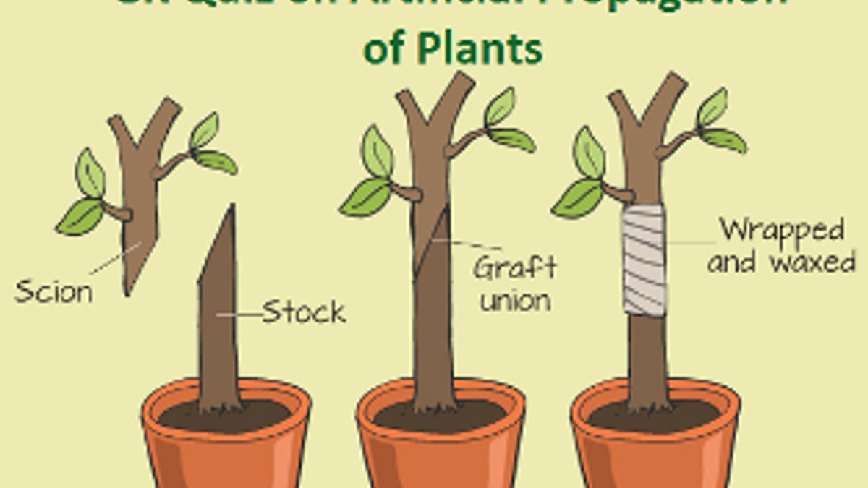
Vegetative Propagation
Grafting
Taking a part of a plant and connecting it to another one.
Combining the two plants.
Some examples are seedless oranges and grapes.

Slide 13
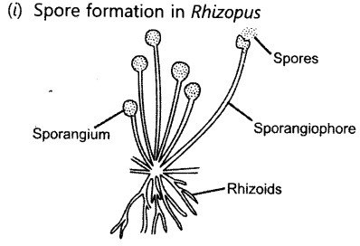
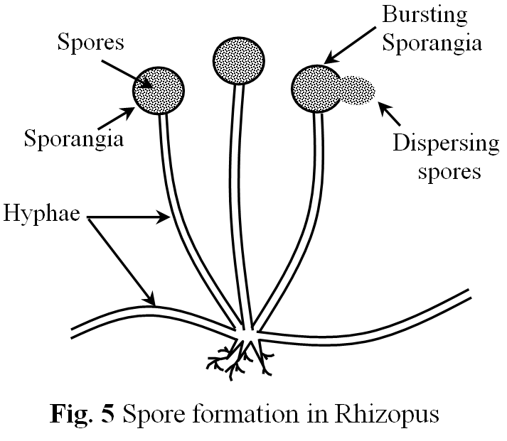
SPORE FORMATION
Spores develop into an individual organism. Eg: Rhizopus.
It develop spores like blob-on-a-stick like structures.

Slide 14
SEXUAL REPRODUCTION IN FLOWERING PLANTS
Sexual Reproduction:
Flower produces gametes which fuse together to produce a new individual
Floral parts: include sepals, petals, stamens and pistil. Stamens-anther and filament

Slide 15
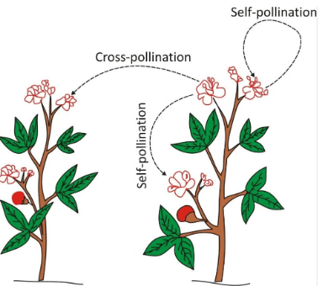
POLLINATION
Transfer of pollen from anther to stigma of a flower
Self-pollination: Pollen is transferred to a stigma of the same flower, or another flower on the same plant
Cross pollination: pollen reaches the stigma of a flower on a different plant (of same species)

Slide 16
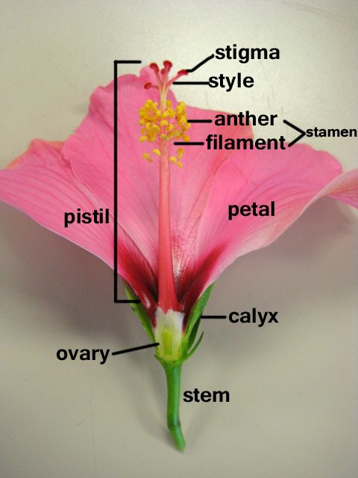
DIAGRAM OF LS OF A FLOWER

Slide 17
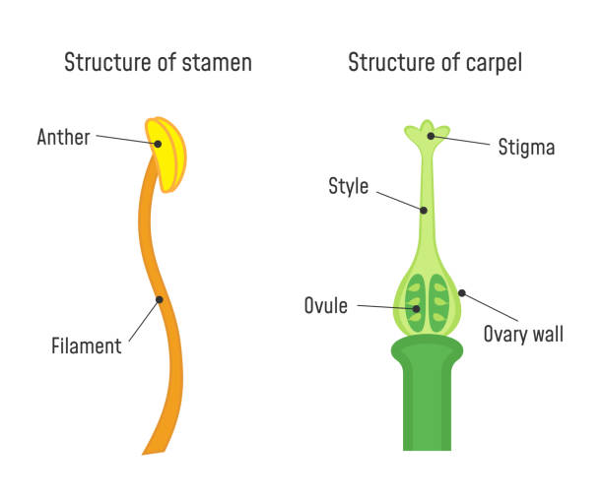
DIAGRAM OF LS OF A FLOWER

Slide 18
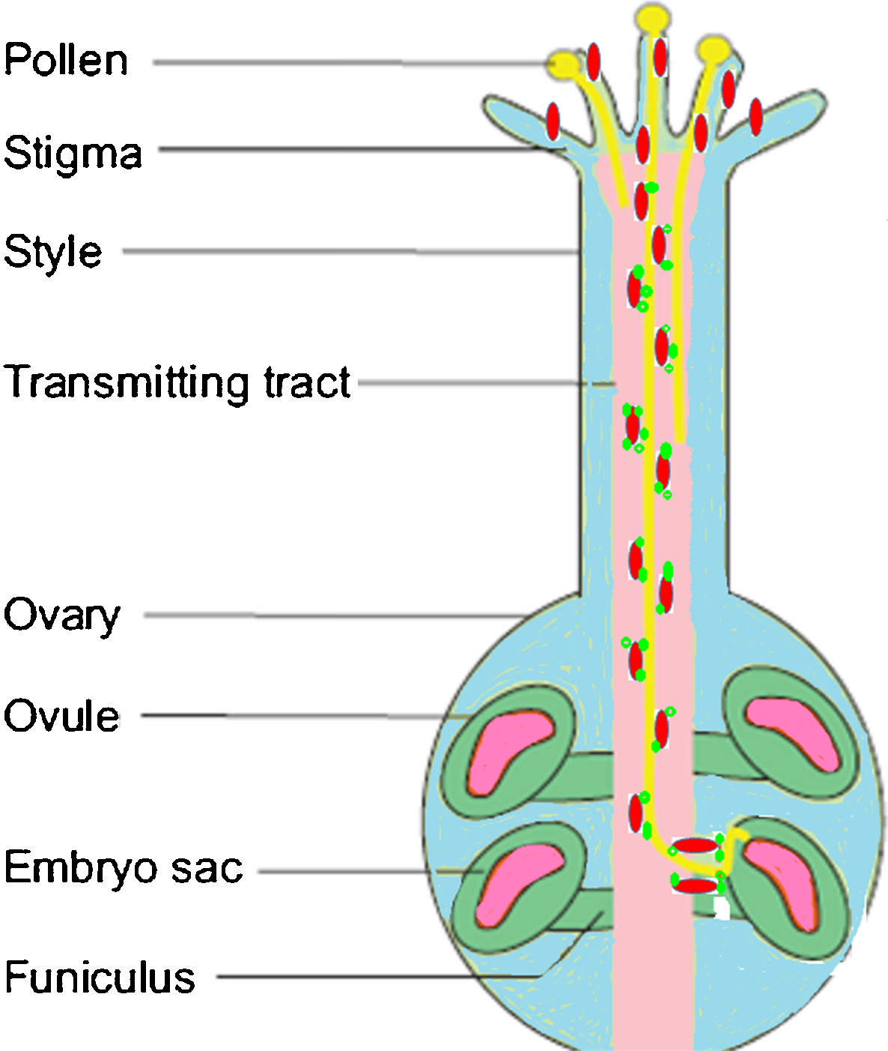
DOUBLE FERTILIZATION
Pollen tube grows along style and reach embryo sac.
One male gamete of pollen fuses with egg cell and forms zygote
Other male gamete fuses with polar nuclei and forms endosperm
Embryo: The growth of a zygote results into an embryo
Seed: ovules- and Fruit-ovary

Slide 19
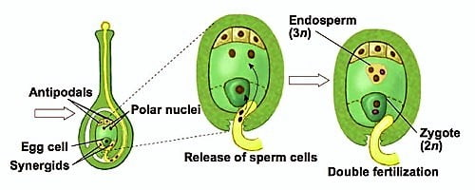
DOUBLE FERTILIZATION

Slide 20
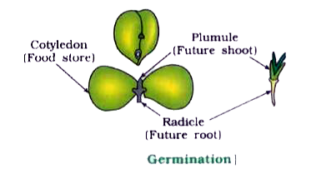
GERMINATION OF A SEED

